Slide 1
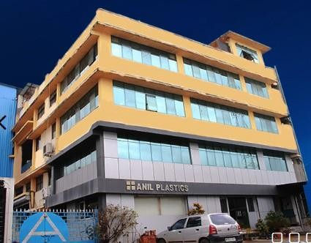
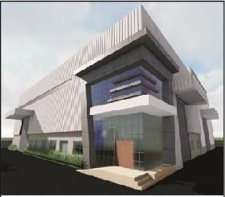
WELCOME
DHOOT TRANSMISSION
Mr. A Rajasekaran
Mr. Kishan Mahale
TO
ANIL PLASTICS AND ENTERPRISES
Since 1994
Plastic Injection Mould Manufacturer & Plastic Moulding
Plot no 16,S.No 253/1/3, Tirumala Ind Estate Hinjewadi Pune. India- 411057
www.anilplastics.com

Slide 2
ANIL PLASTICS AND ENTERPRISES
Since 1994
Plastic Injection Mould Manufacturer & Plastic Moulding
Plot no 16,S.No 253/1/3, Tirumala Ind Estate Hinjewadi Pune. India- 411057
www.anilplastics.com

Slide 3
VISION & MISSION
VISION
MISSION
We at Anil
Plastics
Committed for
At APE we re-define rules of business and are adding a new edge to reach
Assured quality,
prompt and efficient
delivery, highly competitive price in our
customer expectation
aiming for
range of injection moulded plastic components and moulds.
customer delight.
www.anilplastics.com

Slide 4
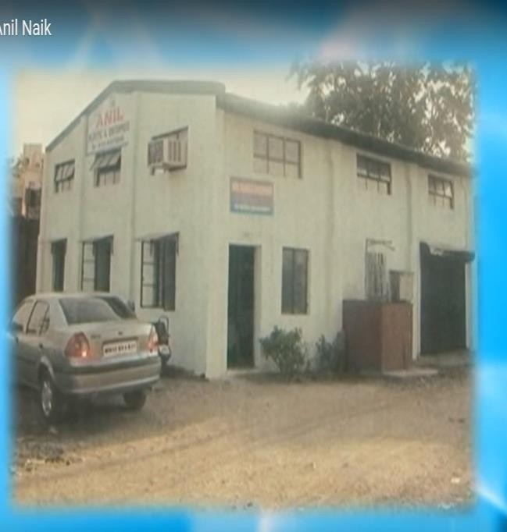
PLANTS OVERVIEWS
Warje Plant – 1994 to 2010
Hinjewadi Plant 1 – 2010
Hinjewadi Plant 2- 2018
Tool Room
Injection Moulding
www.anilplastics.com

Slide 5
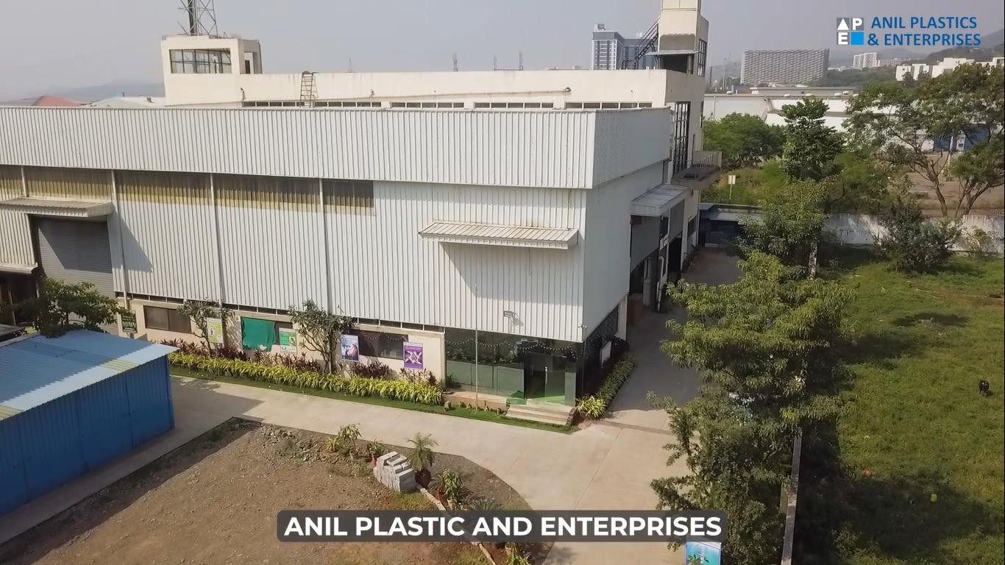
PLANT - 2
Total Area: 4,800 Sq Mtr
Operational Area: 2,350 Sq Mtr
High Tech Facility
Operational from June-18
www.anilplastics.com

Slide 6
HISTORY & MILESTONES
Plastic
Moulding
Tool
Manufacturing
Introduction of
All Electric M/C
Commissioned New Plant 2
1994
2005
2010
2013
2015
2018
2024
Commissioned
New Plant 1
Assembly & Hot Stamping
Target of Implementing Process , Industrial Automation and 4.0
www.anilplastics.com

Slide 7
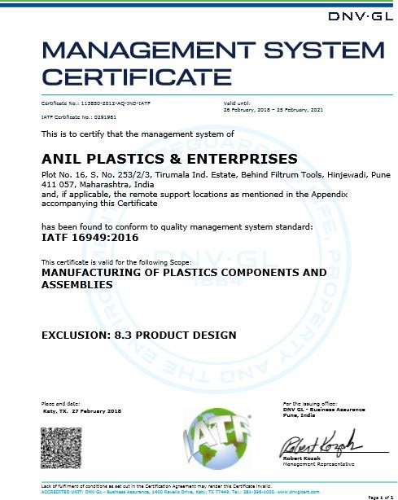
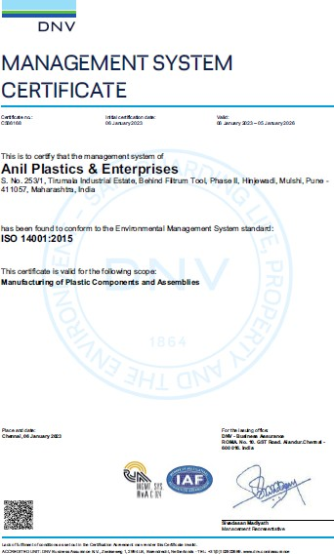
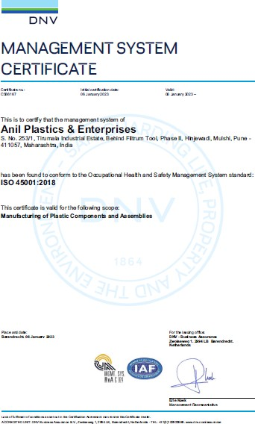
CERTIFICATIONS
QMS/EMS/OHSAS
IATF 16949-2016
ISO 14001-2015
ISO 45001-2018
www.anilplastics.com

Slide 8
ORGANIZATIONAL CHART
Managing Director
AGM- Tool
Room
Operation Head
Marketing & Business development
Finance & Accounting
Tool Room Manager
Head of Molding Section
Sales & Business
Design Manager
PPC,
Production,
Development
Assembly & QA
Project Manager
Maintenance
Tool Quality Manager
Purchase
HR/ Admin
www.anilplastics.com

Slide 9
TOTAL STRENGHT DEPARTMENT WISE
Staff 84
Total Strength 226
Workers 142
Admin &
Others
84
Molding 70
Tooling 32
Sales & Dispatch
8
Assembly 20
Quality 12
www.anilplastics.com

Slide 10
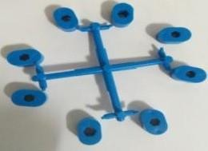
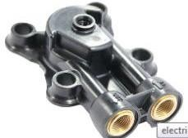
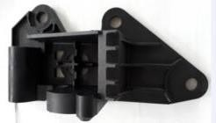
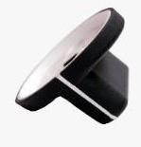
BUSINESS OFFERINGS
Over Moulding
Technical Moulding
Metal – Plastic Insert Moulding
Miniature Moulding
Assembly of Plastic + Metal components
Product Design & Development
Ultrasonic Welding
Tooling.
www.anilplastics.com

Slide 11
OUR CUSTOMERS FROM
We Export to
Schaeffler – Thailand
Curtis Instruments – Bulgaria
Williams Control - China
Williams Control – USA
Kubler – Germany
AQ Wiring System – Lithuania UAB
Rosenberger- China
Erling Klinger -Brazil
Cutis Instruments – USA
Others 15%
Medical 5%
Automobile
35%
Aerospace 10%
Textile 35%
www.anilplastics.com

Slide 12
OUR GROWTH
Overall Turnover
Targeting INR
80.0 Cr for 2023-2024
Turnover (in Cr)
90
80
80
70
60
50
54.5
40
39
30
27
20
16.5
18
10
14
15
0
2016 -17
2017 -18
2018 -19
2019 -20
2020 -21
2021 -22
2022 -23
2023 -24
www.anilplastics.com

Slide 13
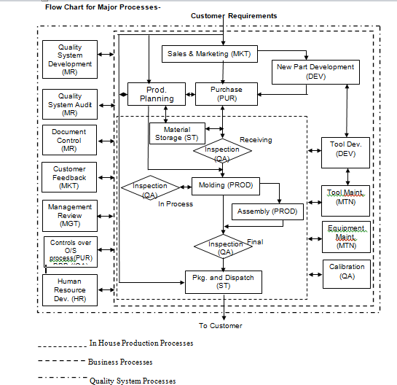
QMS SYSTEM
www.anilplastics.com

Slide 14
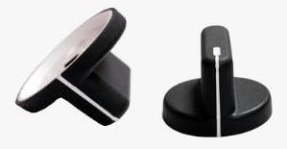
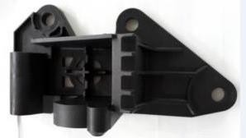
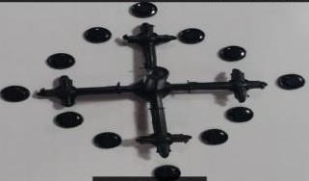
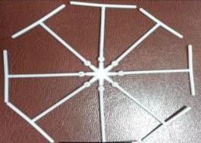
MANUFACTURING PROCESS
OVER MOULDING
INSERT MOULDING
TECHNICAL MOULDING
MICRO MOULDING
www.anilplastics.com

Slide 15
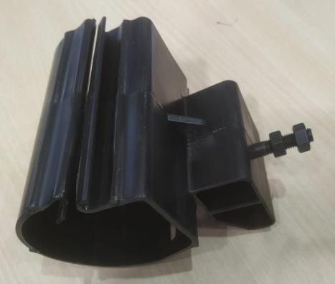
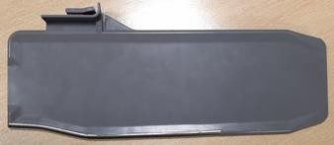
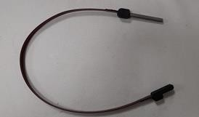
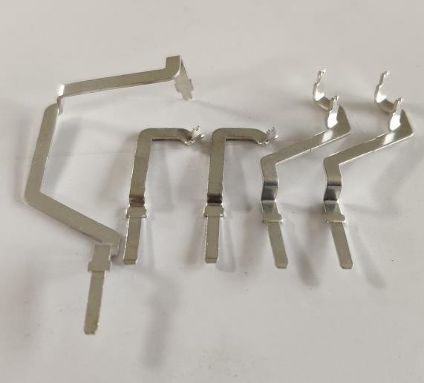
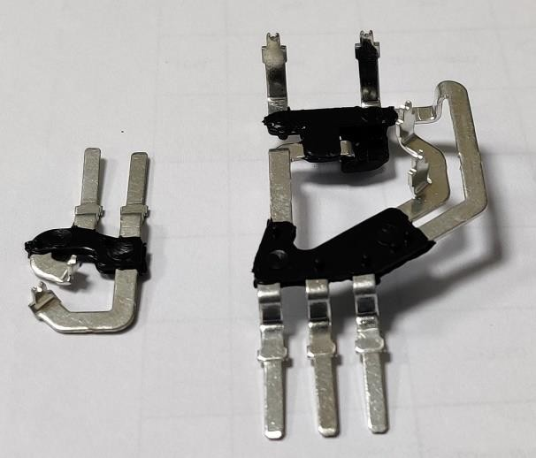
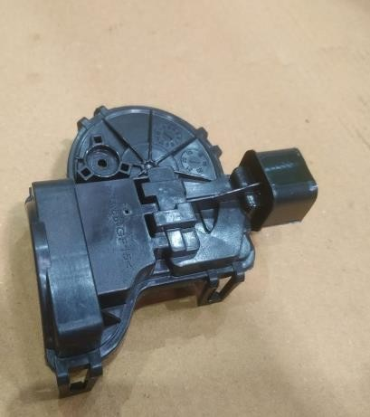
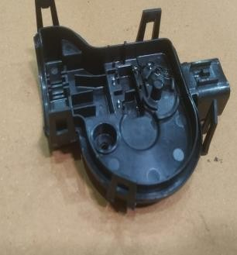
INSERT MOULDED PARTS
Brass Insert
MS Nut
SS Tube
MS Nut
Insert
1st Moulding
2nd Moulding
www.anilplastics.com

Slide 16
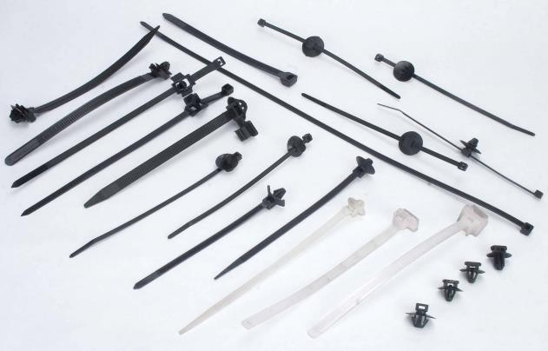
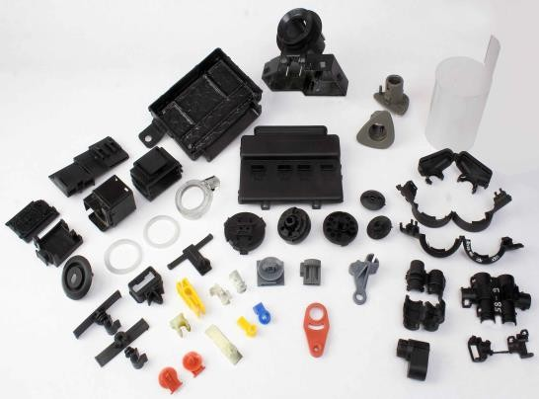
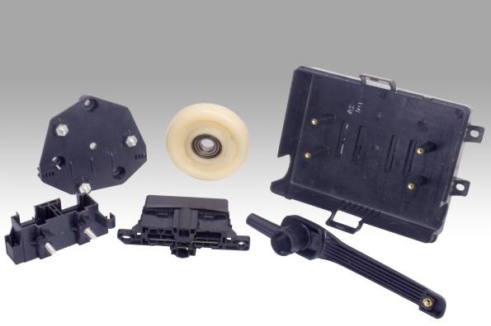
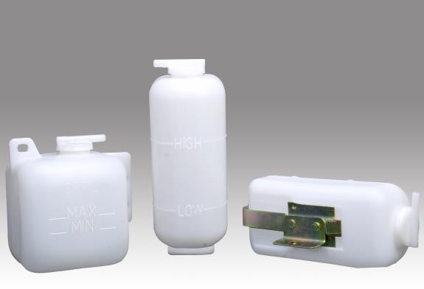
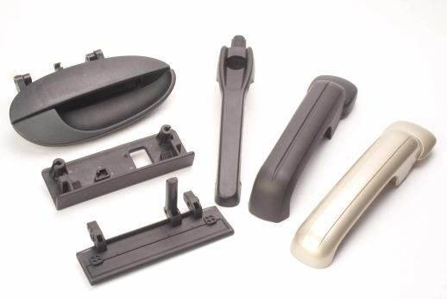
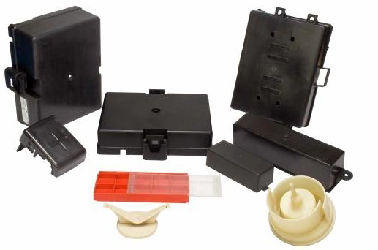
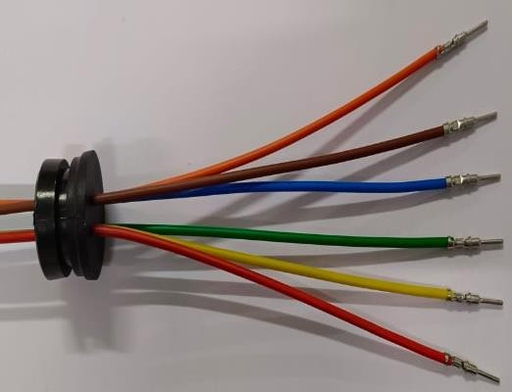
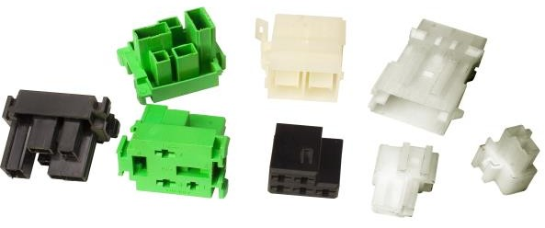
AUTO COMPONENTS
Cable Tie & Auto Clips
Engineering Parts
Customized Components
Coolant bottles
Connectors
Automotive handles
Fuse Boxes & Covers
DP Pass through

Slide 17
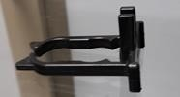
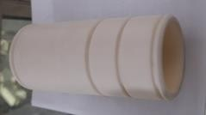
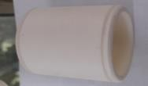
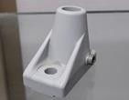
PLASTIC PARTS
Insert
Holder F
Handle Groove
Cover Hood
Clamping Element
Bushing Big
Bushing Small
Bracket Top
www.anilplastics.com

Slide 18
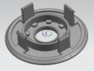
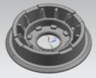
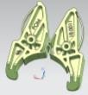
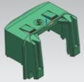
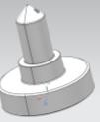
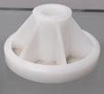
PLASTIC PARTS
Pulley 1Lift Mechanism Pulley 2Lift Mechanism
Brake Shoe
OBEN
UTEN
Bremshel
TRAY 18,2/27
Carrier/Tube Ø18.3
Carrier/Tube Ø19.6
Traction Support Roller
www.anilplastics.com

Slide 19
MATERIAL HANDLED
Specialty Plastics
PEEK 450 G Victrex PEEK 150FW30- Victrex
LCP – Liquid crystal polymer
PPS GF40%
PA 46/H Stanyl TW 341 SW11000 PA 6 CF 10 TF 20
PA11-RILSAN PC+ABS-BAYBLEND
Thermoplastic Elastomers
TPE-U (Polyurethane ) TPE- Kraiburg
PVC-Kadakia
Others
PP
PP Talc/Glass Filed LDPE/HDPE
Hi-Tech Engineering Plastics (Unfilled and Filled)
PA11, PA12- Evonik
PBT GF 30% - VALOX /SABIC PC + PBT
ABS GF 15%
PA 6 & 66 – Plain & GF - BASF/DUPONT PC LEXAN 2407 -SABIC
POM K,MR- Polyplast POM H,MR- Polyplast PA66-CF10-TF20
Master Batch
CALIRENT
POLY ONE
www.anilplastics.com

Slide 20
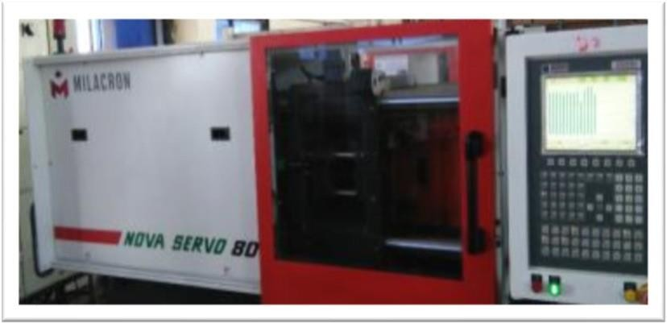
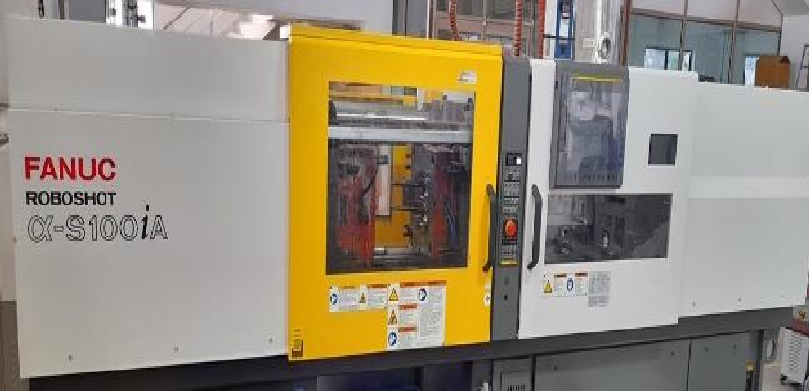
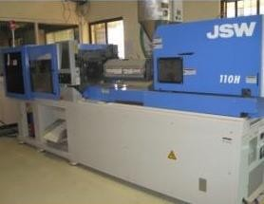
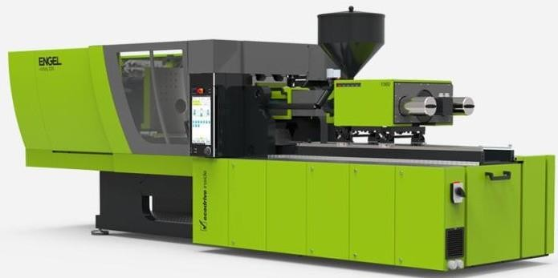
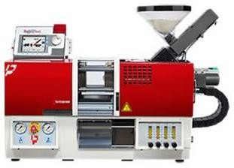
 | MOULDIN | G MACHINES: 2 | 8 NOs
Sr No. | MACHINE TONNAGE | MAKE | QTY (in No.)
1 | 250T, 200T, 150T, 110T, 80T, 50T, | FERROMATIC | 11
2 | 150T, 100T, 50T, 60T | FANUC | 5
3 | 150T,140T, 85T, 55T, | JSW ALL ELECTRIC | 5
4 | 220T, 60T | ENGEL | 2
5 | 50T | TOYO | 2
6 | 100T | TOSHIBA ALL ELECTRIC | 1
7 | 160T | SUZHOU LIZHU MACHINERY CO. LTD- VERTICAL | 1
8 | 6T | BABY PLAST | 1
_{stics.com} Total No. Of Injection Moulding Machines |  |  | 28
www.anilpla

Slide 21
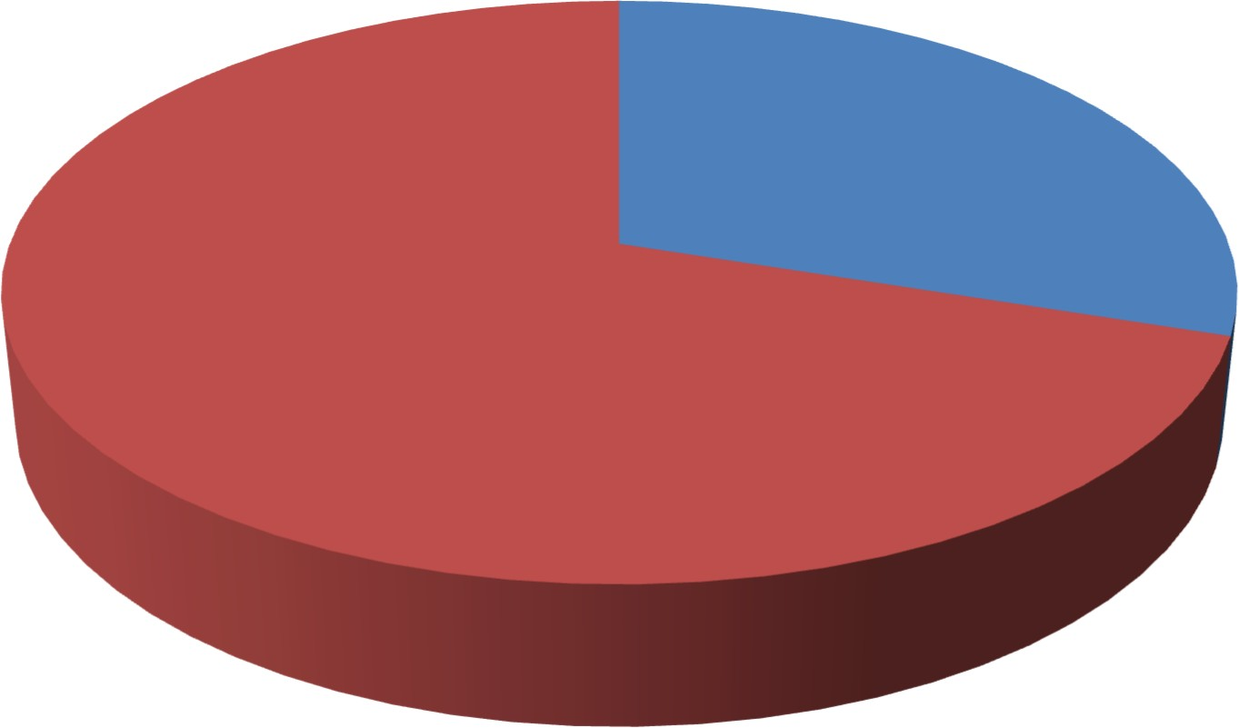
FREE CAPACITY
Free Capacity 20%
Used Capacity 80%
Whenever we reach our capacity above 80-90%, we increase our capacity by 20% and always keep free capacity for new business
www.anilplastics.com

Slide 22
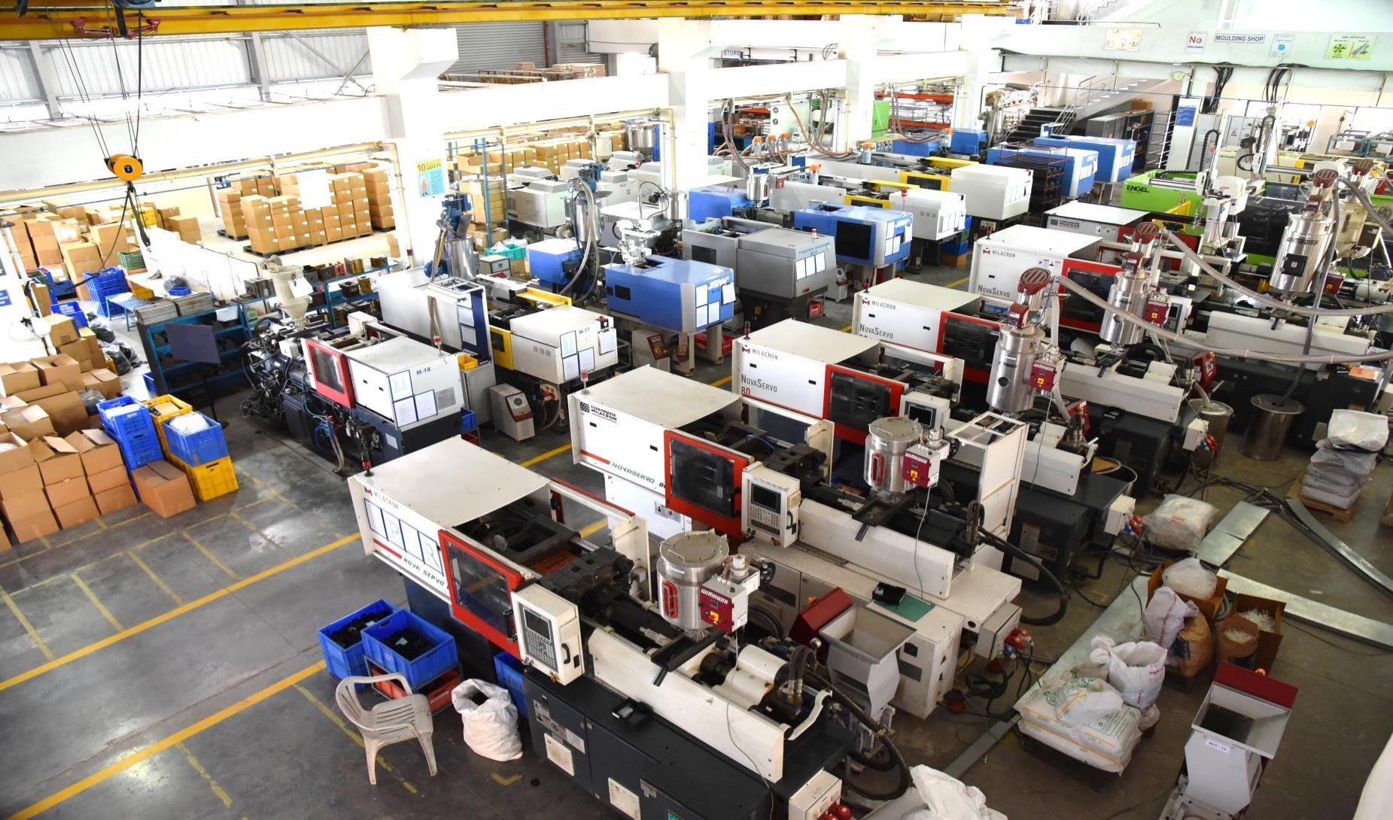
PLANT -2 GROUND FLOOR MOULDING MACHINE SECTION
www.anilplastics.com

Slide 23
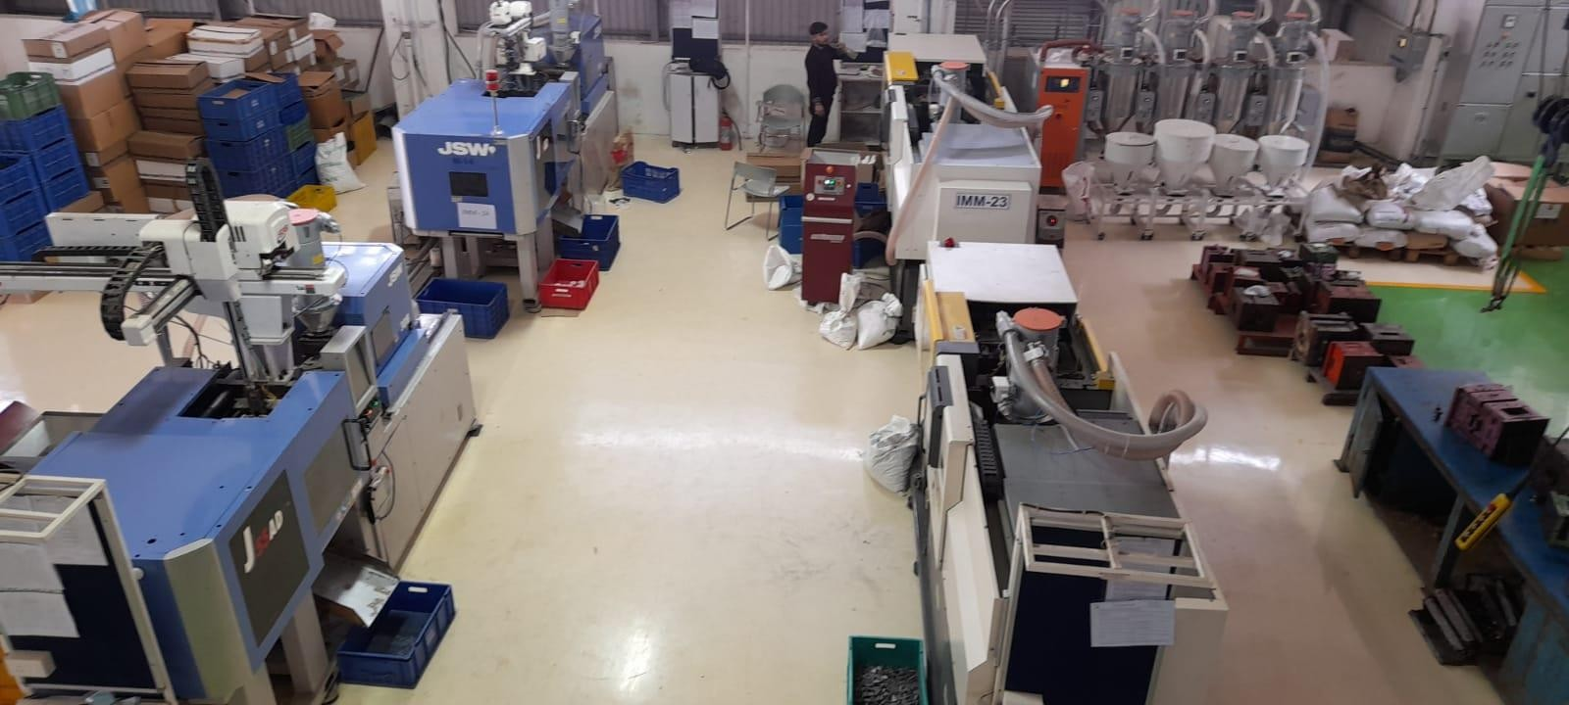
PLANT -2 SECOND FLOOR
MOULDING MACHINE SECTION
www.anilplastics.com

Slide 24
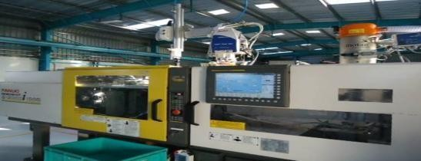
MOULDING MACHINES
Hydraulic M/C Ferromatic & Mitsubishi
All Electric: JSW & Toshiba
New FANUC ROBOSHOT Alpha-S100iA 200mms
All Electric : Fanuc
www.anilplastics.com

Slide 25
FEATURES - ENGLE MACHINE
Vertical
Short Capacity : 510gm.
Tie Bar Less Machine.
Mould can be loaded on the Machine 700X700mm.
Up to 408gm Component can be Moulded .
M/C Tonnage : 60 Ton
Shot Capacity : 53 Cm³
Screw Diameter: 22 mm
Max Distance between
Platen : 520mm
Platen Size : 940*400mm (Horizontal * Vertical)
Min. Mold Height : 190mm
Max. Mold Weight : 1350 Kg
Horizontal
www.anilplastics.com

Slide 26
BABY PLAST / MINIATURE
MOULDING MACHINE
www.anilplastics.com

Slide 27
NEW ASSEMBLY LINE SETUP
www.anilplastics.com

Slide 28
FEATURES OF ASSEMBLY
Assembly Of Plastics ,Metal , Ceramic & Magnet
Printing(Hot stamping)
Ultrasonic Welding
www.anilplastics.com

Slide 29
3D PRINTING MACHINE FOR MAKING PROTOTYPES
Specifications :
Print Technology Build Volume
Layer Resolution Settings Advanced Wall Thickness Minimal
: LPD - Layer Plastic Deposition
: 200 x 200 x 185mm
: 25-50 Microns.
: 400 Microns
www.anilplastics.com

Slide 30
SPECIALTY: CAMERA
INSPECTION MACHINE
Newly Added one more Machine for 100% Part Inspection
www.anilplastics.com

Slide 31
TOOLROOM
Manufacturing Capacity : 8 to 10 Tool Per Month
Type of Moulds
Multicavity
Insert
Over mould
Proto mould, Miniature mould
Hot Runner
Capacity to develop the mould size up to 650Ton.
Optimize lead time:
Export Quality Tools
Best Optimize Design
Tooling & Technical Expertise
Simple 2 Plate Moulds | 30 Days
3 Plate Moulds | 45 Days
Any Critical A class Moulds | 60-90 Days
www.anilplastics.com

Slide 32
MOULDS MANUFACTURED
100 Tools /Year
Multi cavities molds
Over Molds
Hot Runner Molds
www.anilplastics.com

Slide 33
DEVELOPMENT PROCESS
www.anilplastics.com

Slide 34
RECENT DEVELOPMENT
Metal To plastic Conversion
Soft Tooling(Prototype) Hardened Production tools.
www.anilplastics.com

Slide 35
RECENT DEVELOPMENT
Over Moulding
www.anilplastics.com

Slide 36
RECENT DEVELOPMENT
With gear Mechanism
www.anilplastics.com

Slide 37
RECENT DEVELOPMENT
www.anilplastics.com

Slide 38
MACHINE FACILITIES
VMC Machines
MAKINO TS-105
HAAS VMC VF-4
HAAS VMC VF-2-1
www.anilplastics.com

Slide 39
MACHINE FACILITIES
EDM Machine
MITSUBISHI EDM - EA12S
MITSUBISHI EDM –SG12
DM ELECTRONICA D300 ZNC
www.anilplastics.com

Slide 40
MACHINE FACILITIES
Wirecut Machine
Mitsubishi MV-1200S CNC Wire-cut
Sparkonix EDM Drill Speed ii
www.anilplastics.com

Slide 41
MACHINE FACILITIES
Conventional Machines
LMW CNC Lathe With Fanuc Controller.
Okamato Surface Grinding Machine
Kent Surface Grinder
www.anilplastics.com

Slide 42
MACHINE FACILITIES
Metrology
Vision Measurement
System
- Mitutoyo M/C
Height Measuring Gauge - Trimos_v7
Profile Projector
- Mitutoyo
Muffle Furnace
www.anilplastics.com

Slide 43
FACILITY
DESIGN DEPARTMENT
CAD-CAM DEPARTMENT
www.anilplastics.com

Slide 44
TOOLSHOP
Tool Assembly
Conventional Machines
www.anilplastics.com

Slide 45
TOOLROOM - MACHINE LIST
Sr No. | DISCRIPTION | BRAND | QUANTITY | SIZE
1 | CNC EDM | MITSUBISHI | 2 | 400 x 300 x 360
2 | ZNC EDM | ELECTRONICA | 1 | 400 x 300 x 250
3 | WIRE EDM | MITSUBISHI | 1 | 450 x 350 x 220
5 | EDM DRILL | SPARKONIX | 1 | 300 x 250 x 200
6 | VMC | MAKINO | 1 | 920 × 510 x 610
7 | VMC | HAAS VF 4 | 1 | 1270 × 508 x 635
8 | VMC | HAAS VF 2 | 1 | 762 × 406 x 508
9 | SURFACE GRINDING | KENT | 1 | 600 × 250
10 | SURFACE GRINDING | OKAMOTO | 1 | 450 x 150 x 250
11 | SURFACE GRINDING | JOHN AND SHIPMAN | 1 | 600 x200 x 250
12 | RADIAL DRILL | ELLIOTT | 1 | 1000 x 1000 x 1000
13 | LATHE | TOP TECH | 1 | 5 FT
14 | UNIVERSAL MILLING | ARGO | 1 | 1000 × 360 x 350
15 | UNIVERSAL MILLING | ARGO | 1 | 1000 × 360 x 300
16 | MILLING | 3M GAMBIN | 1 | 1200 × 500 x 400
17 | BENCH GRINDING | PROTH | 1 | 8”
18 | PROFILE PROJECTOR | MITUTOYO | 1 | Dia 400
19 | VMM | MITUTOYO | 1 | 250 × 200 x 150
20 | HEIGHT MASTER | TRIMOS V7 | 1 | 700
www.anilplastics.com

Slide 46
CUSTOMER: AUTOMOTIVE
www.anilplastics.com

Slide 47
CUSTOMER: TEXTILE
CUSTOMER: AEROSPACE & TELECOM
CUSTOMER: MEDICAL
www.anilplastics.com

Slide 48
CUSTOMER: OTHERS
www.anilplastics.com

Slide 49
AWARDS
Supplier of the year award
2014
Rieter India
Best delivery award 2015
Rieter India
Best of the best Supplier award
2006-2007
Tyco Electronics
Best Supplier award
2006-2007
Tata Yazaki
Best Emerging Supplier award 2005-2006
Tata Yazaki
www.anilplastics.com

Slide 50
FUTURE PLANS
Installation of Zeiss CMM
Focus on entire assembly products along with molding
Addition of 400Tn to1000Tn world class Injection Molding Machine.
www.anilplastics.com

Slide 51
THANK YOU
www.anilplastics.com

